Slide 1
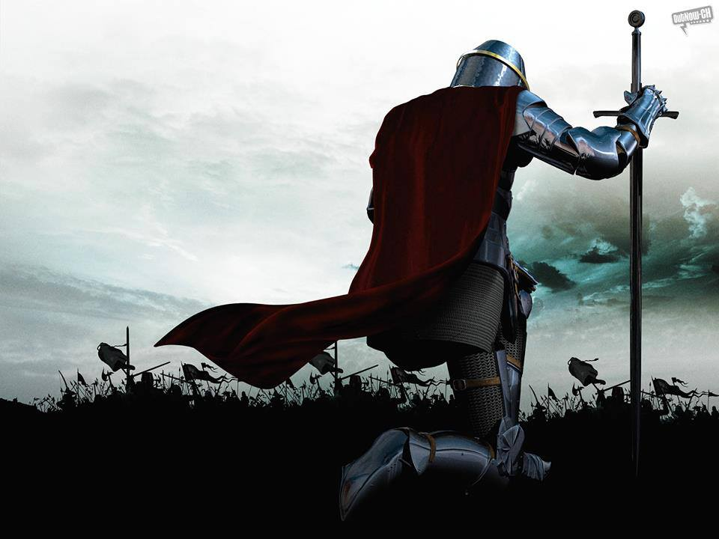

Slide 2
School Song
May God Bless Our School
As we march to our tomorrows
And stand tall today in faith, hope, and love
We rise to build our nation,
With wisdom, stature, and favor
May God bless our school today and forever

Slide 5
Accolade Winners – Great Job

Slide 6
POW WOW - Responsibility

Slide 7
Character Trait Definition
RESPONSIBLE
ADJECTIVE
having an obligation to do something, or having control over or care for someone, as part of one's job or role:

Slide 8
Responsibility in School

Slide 9
Scenarios
Hallway
Lunch Room
Classroom

Slide 10
COLLEGE SLIDE: Remember students, we are preparing ourselves for COLLEGE each and every day. Be RESPONSIBLE and choose to make this a productive day for yourself and others. Remember it’s always your CHOICE. Have a RESPONSIBLE week!

